Slide 1

TRAVEL AGENCY WEBSITE

Slide 2
PROBLEM STATEMENT
The travel agency is seeking to enhance its operations through the development of an online platform that will facilitate booking flights, hotels, and vacation packages.
The primary objectives include creating a seamless user registration and authentication system, complete with secure login, password recovery, and social media login options.
Users will have access to a personalized dashboard where they can manage bookings, update personal information, and review their booking history.
The platform will also integrate a secure payment gateway to handle online transactions

Slide 3

ABSTRACT
At Travel Agency, we specialize in turning your travel dreams into unforgettable realities.
An adventurous mountain trek, or an immersive cultural exploration, our expert team is dedicated to crafting personalized travel experiences that exceed your expectations.
The website for the Travel Agency is crafted to offer a seamless and enjoyable user experience.
With a focus on visual appeal, the site features high-quality images, interactive maps, and engaging multimedia content to vividly showcase various destinations.
Continuous optimization based on user feedback and performance metrics helps to keep the website effective and user-friendly.

Slide 4
EXISTING WORK
The travel agency’s existing system features a user-friendly registration form integrated with a database to store user details.
A contact form is also available, capturing full name, email, phone number, and messages, and is linked to a dbcontact. php script for efficient management.
User login includes validation for usernames (comprising uppercase, lowercase, and numeric characters), passwords (numeric only, with a minimum length of 8), and email addresses (ensuring valid formats).
Various forms of data are stored in a database, including user credentials, booking details, and contact messages.
User login includes validation for usernames (comprising uppercase, lowercase, and numeric characters), passwords (numeric only, with a minimum length of 8), and email addresses (ensuring valid formats).

Slide 5
PROPOSED WORK
To enhance the travel agency system, several new features could be implemented. User profiles could be introduced to allow individuals to manage their personal information, travel history, and preferences.
Advanced search filters would enable users to find tours based on location, price range, activity type, and duration. A real-time availability system could provide up-to-date information on tour packages and hotel bookings.
Adding a booking history and management feature would let users view, manage, and cancel bookings directly. Incorporating a review and rating system would help users make informed decisions, while personalized recommendations could suggest tours based on user preferences and past bookings.
Integration with interactive maps could highlight routes and points of interest. Multi-language support and a mobile app would cater to a broader audience, and live chat support could offer real-time assistance.
Special offers and discounts, a travel itinerary builder, and social media integration could further enhance user engagement.
Automated reminders and notifications, along with dynamic pricing models, would streamline the booking process and adapt to market conditions.

Slide 6
MODULE DESCRIPTION
The travel agency system is organized into several key modules, each designed to enhance different aspects of the user experience.
The Booking Management Module handles all booking-related activities, allowing users to search for flights, hotels, and vacation packages based on criteria such as destination and dates.
The User Management Module focuses on managing user accounts and profiles.
It supports account creation, login, and password recovery, and allows users to update personal information, preferences, and view their booking history.
The Itinerary Management Module aids users in planning and managing their travel itineraries. t enables users to create custom itineraries that include flights, hotels, and activities, view detailed trip plans, and receive notifications about upcoming trips, changes, or important reminders.

Slide 7
The Customer Support Module is designed to provide assistance and support to users.
It features a helpdesk system for reporting issues or requesting support, a live chat function for real-time assistance, and an FAQ and knowledge base for self-service support.
The Content Management Module manages travel-related content on the platform.
It allows administrators to update dynamic content such as destination guides, travel tips, and promotional offers, and handles the upload and display of media such as images and videos.
The Data Analytics and Reporting Module provides insights into booking trends, customer behavior, and financial performance.
It includes functionalities for generating reports on bookings, revenue, and user activity, a visual dashboard for key metrics and analytics, and data export capabilities in various formats.

Slide 8
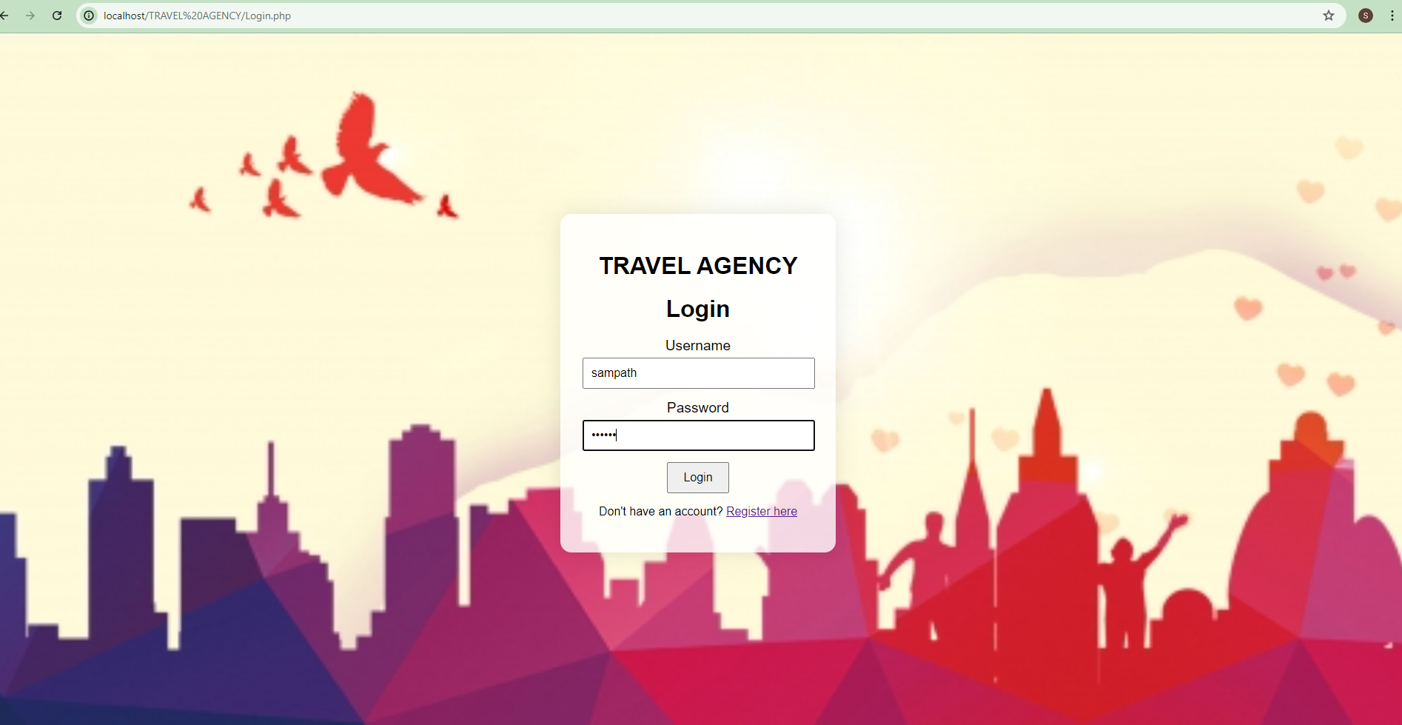
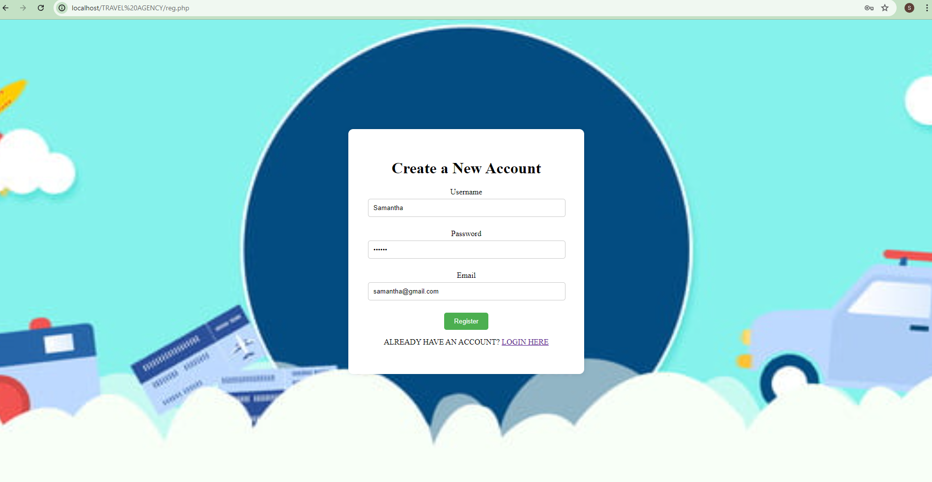
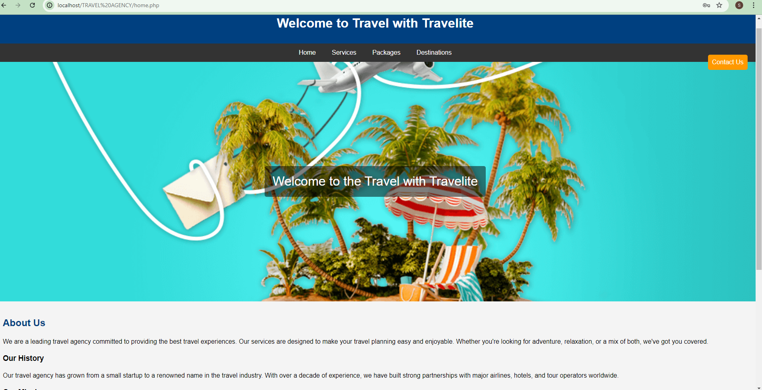
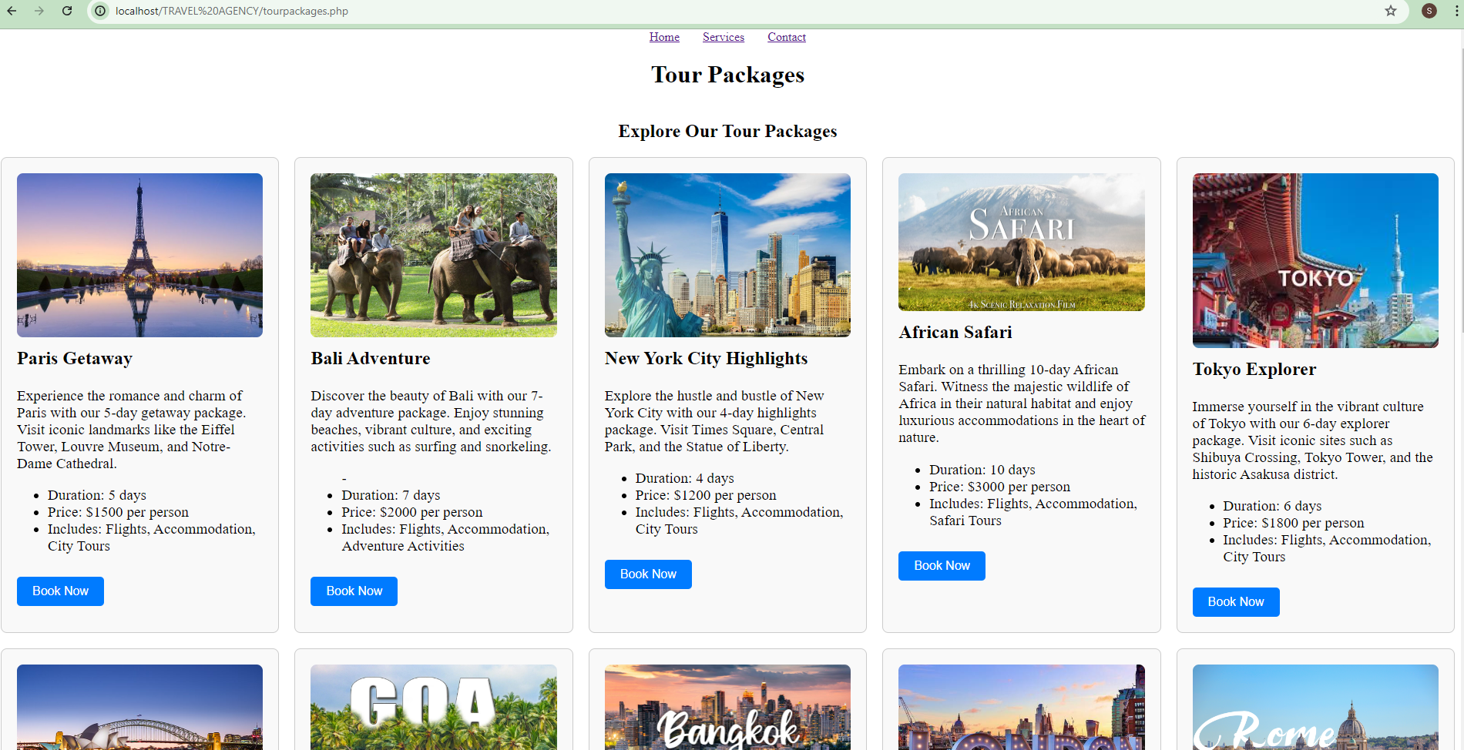
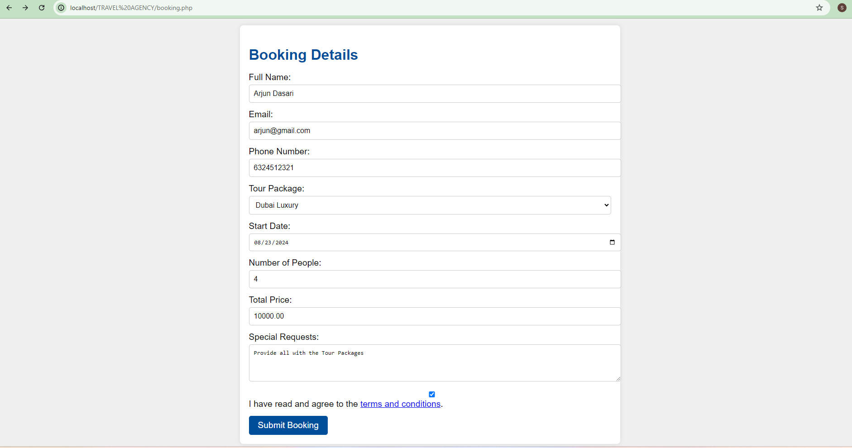
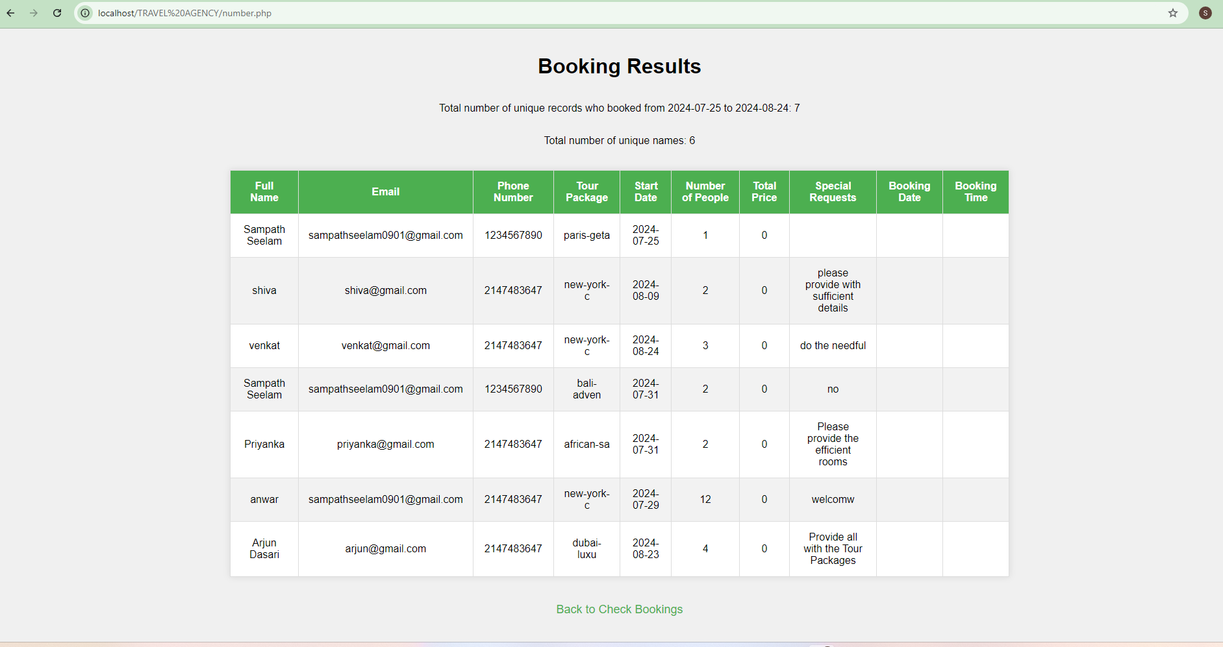
SCREENSHOTS

Slide 9
CONCLUSION
The "Travel Agency" project aims to revolutionize the travel booking experience by providing a comprehensive, user-friendly platform for managing flights, accommodations, and itineraries.
He travel agency system is designed to provide a comprehensive and user-friendly experience for managing travel arrangements.
Users benefit from intuitive search and booking processes, personalized itineraries, and robust support options, while administrators have the tools needed for content updates and performance analysis.
The travel agency can offer a seamless and engaging platform that meets the diverse needs of travelers and enhances overall satisfaction.

Slide 10

FUTURE ENHANCEMENT
The travel agency platform can greatly enhance user experience by offering personalized travel recommendations and advanced chatbots for real-time support.
Enhanced data analytics and predictive tools will aid in accurate trend forecasting and decision-making.
Expanding multilingual support and localizing content will cater to a global audience, while sustainability features.
Offering options for eco-friendly travel and accommodations, reservations.
Implementing advanced security measures such as biometric authentication and enhanced encryption to protect user data and transactions.

Slide 11
REFERENCES
1.Lee, Jenny Ji-Yeon, et al. "Developing, operating, and maintaining a travel agency
website: Attending to e-consumers and Internet marketing issues." Journal of Travel &
Tourism Marketing 17.2-3 (2005): 205-223.
2. Huang, Han-Chen. "Research on key factors of travel agency website service
quality." World Journal of Advanced Research and Reviews 23.2 (2024): 001-010.
3. Park, Young A., Ulrike Gretzel, and Ercan Sirakaya-Turk. "Measuring web site quality
for online travel agencies." Journal of Travel & Tourism Marketing 23.1 (2007): 15-30.
4. Law, Rob, Basak Denizci Guillet, and Rosanna Leung. "An analysis of the lowest fares
and shortest durations for air-tickets on travel agency websites." Journal of Travel &
Tourism Marketing 27.6 (2010): 635-644.

Slide 12
thank you
S. Sampath Kumar Reddy (192211974)
K. Rakesh (192211802)
SK. Anwar(192211801)

